Slide 1

Chapter 14 ::
Building a Runnable Program
Programming Language Pragmatics
Michael L. Scott
Copyright © 2009 Elsevier

Slide 2
Introduction
The phases of compilation are commonly grouped in
  front end responsible for the analysis of source code
  back end responsible for the synthesis of target code.
Chapters 2 and 4 discussed the work of the front end, culminating in the construction of a syntax tree
The current chapter turns to the work of the back-end, and specifically to code generation, assembly, and linking
We continue with code improvement in Chapter 15
Now we look at how the compiler produces that code from a syntax tree, generating a runnable program
Copyright © 2009 Elsevier

Slide 3
Back-End Compiler Structure
A plausible seven-phase structure for a conventional compiler is shown in Figure 14.1:
  First three phases (scanning, parsing, and semantic analysis) are language-dependent
  Last two (target code generation and machine-specific code improvement) are machine dependent
  The middle two (intermediate code generation and machine-independent code improvement) are dependent on neither the language nor the machine
The scanner and parser drive a set of action routines that build a syntax tree
The semantic analyzer traverses the tree, performing all static semantic checks and initializing various attributes of use to the back end
Copyright © 2009 Elsevier

Slide 4
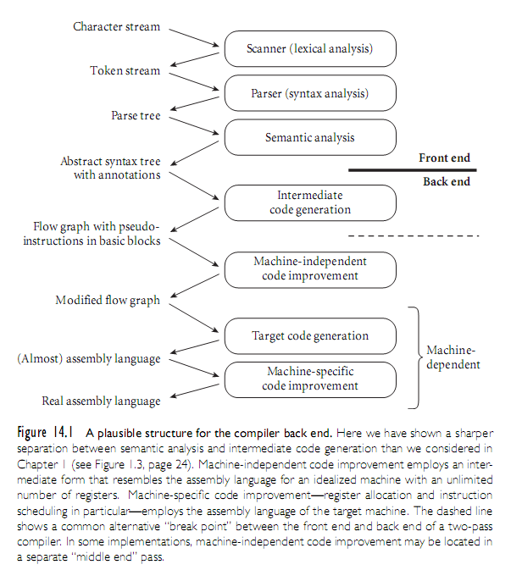
Back-End Compiler Structure
Copyright © 2009 Elsevier

Slide 5
Back-End Compiler Structure
Certain code improvements can be performed on syntax trees - a less hierarchical representation of the program makes most code improvement easier
Our example compiler therefore includes an explicit phase for intermediate code generation
  The code generator groups the nodes into basic blocks
  It then creates a control flow graph in which the nodes are basic blocks and the arcs represent interblock control flow
    Within each basic block, operations are represented as instructions for an idealized RISC machine with an unlimited number of registers - we will call these virtual registers
    By allocating a new one for every computed value, the compiler can avoid creating artificial connections between otherwise independent computations too early in the compilation process
Copyright © 2009 Elsevier

Slide 6
Back-End Compiler Structure
The second phase of the back end machine-independent code performs transformations on the control flow graph.
  local code improvement - it modifies the instruction sequence within each basic block to eliminate redundant loads, stores, and arithmetic computations
  global code improvement - it also identifies and removes a variety of redundancies across the boundaries between basic blocks within a subroutine
  an expression whose value is computed immediately before an if statement need not be recomputed after else
  An expression that appears within the body of a loop need only be evaluated once if its value will not change in subsequent iterations
Some global improvements change the number of basic blocks and/or the arcs among them
Copyright © 2009 Elsevier

Slide 7
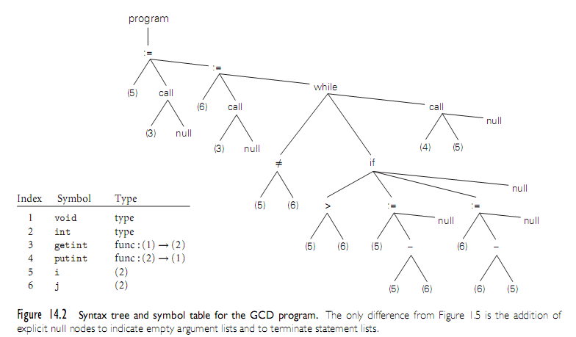
Back-End Compiler Structure
Copyright © 2009 Elsevier

Slide 8
Back-End Compiler Structure
Following machine-independent code improvement, the next phase of compilation is target code generation
  This phase strings the basic blocks together into a linear program, translating each block into the instruction set of the target machine and generating branch instructions (or “fall-throughs”) that correspond to the arcs of the control flow graph.
The output of this phase differs from real assembly language primarily in its continued reliance on virtual registers
Copyright © 2009 Elsevier

Slide 9
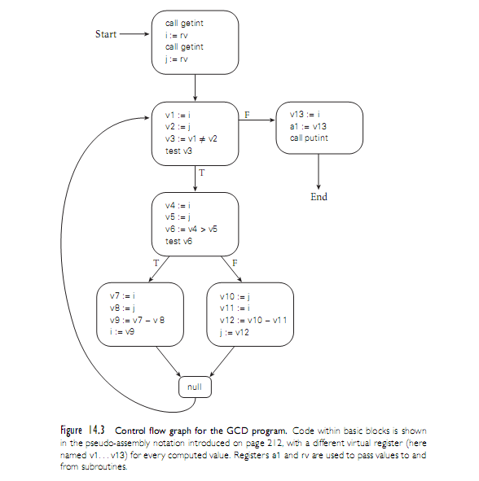
Back-End Compiler Structure
Copyright © 2009 Elsevier

Slide 10
Back-End Compiler Structure
The final phase of our example compiler structure consists of register allocation and instruction scheduling - machine-specific code improvement
Register allocation requires that we map the unlimited virtual registers onto the bounded set of registers available in the target machine
  If there aren’t enough architectural registers to go around, we may need to generate additional loads and stores to multiplex a given architectural register among two or more virtual registers
  As described in Section 5.5, instruction scheduling consists of reordering the instructions of each basic block to fill the pipeline(s) of the target machine
Copyright © 2009 Elsevier

Slide 11
Back-End Compiler Structure
Phases and Passes
  A pass of compilation is a phase or sequence of phases that is serialized with respect to the rest of compilation
    it does not start until previous phases have completed
    it finishes before any subsequent phases start.
    if desired, a pass may be written as a separate program, reading its input from a file and writing its output to a file.
  Two-pass compilers are particularly common
    they may be divided between the front end and the back end (between semantic analysis and intermediate code generation)
    or
    they may be divided between intermediate code generation and global code improvement
    In the latter case, the first pass is still commonly referred to as the front end and the second pass as the back end
Copyright © 2009 Elsevier

Slide 12
Intermediate Forms
An intermediate form (IF) provides the connection between the front end and the back end of the compiler, and continues to represent the program during the various back-end phases.
IFs can be classified in terms of their level, or degree of machine dependence.
High level IFs
  IFs are often based on trees or directed acyclic graphs (DAGs) that directly capture the structure of modern programming languages
  facilitates certain kinds of machine-independent code improvement, incremental program updates, direct interpretation, and other operations based strongly on the structure of the source
  Because the permissible structure of a tree can be described formally by a set of productions (cf., Section 4.6), manipulations of tree-based forms can be written as attribute grammars
  Stack-based languages are another common type of high level IF
Copyright © 2009 Elsevier

Slide 13
Intermediate Forms
The most common medium level IFs consist of three-address instructions for a simple idealized machine, typically one with an unlimited number of registers
  Since the typical instruction specifies two operands, an operator, and a destination, three-address instructions are called quadruples
  In older compilers, one may sometimes find an intermediate form consisting of triples or indirect triples in which destinations are specified implicitly
    the index of a triple in the instruction stream is the name of the result
    an operand is generally named by specifying the index of the triple that produced it.
Copyright © 2009 Elsevier

Slide 14
Intermediate Forms
Different compilers use different Ifs
  Many compilers use more than one IF internally, though in the common two-pass organization one of these is distinguished as “the” intermediate form
    connection between the front end and the back end.
  the syntax trees passed from semantic analysis to intermediate code generation constitute a high level IF
  control flow graphs containing pseudo-assembly language (passed in and out of machine-independent code improvement) are a medium level IF
  the assembly language of the target machine serves as a low level IF
Compilers that have back ends for different target architectures do as much work as possible on a high or medium level IF
  the machine-independent parts of the code improver can be shared by different back ends
Copyright © 2009 Elsevier

Slide 15
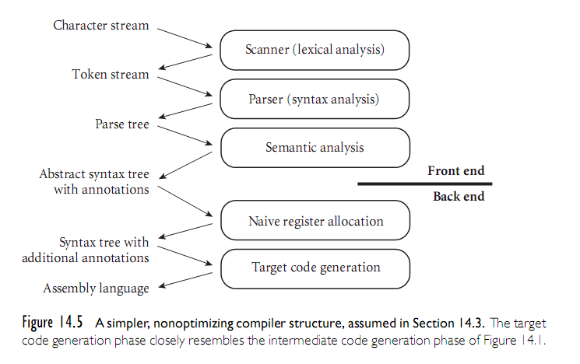
Intermediate Forms
Copyright © 2009 Elsevier

Slide 16
Code Generation
The back end of Figure 14.1 is too complex to present in any detail in a single chapter
  To limit the scope of our discussion, we will content ourselves in this chapter with producing correct but naive code
  This choice will allow us to consider a significantly simpler back end.
  Starting with Figure 14.1, we drop the machine-independent code improver and then merge intermediate and target code generation into a single phase
    generates linear assembly language - no code improvements for control flow, therefore, there is no need to represent that flow explicitly in a control flow graph
Copyright © 2009 Elsevier

Slide 17
Code Generation
We also adopt a much simpler register allocation algorithm
  operates directly on the syntax tree prior to code generation - eliminates need for virtual registers and the subsequent mapping onto architectural registers
Finally, we drop instruction scheduling. The resulting compiler structure appears in Figure 14.5.
  Its code generation phase closely resembles the intermediate code generation of Figure 14.1.
An Attribute Grammar for GCD Example is presented in Section 14.3.1
Copyright © 2009 Elsevier

Slide 18
Code Generation
Register Allocation
  Evaluation of the rules of the attribute grammar itself consists of two main tasks
  In each subtree we first determine the registers that will be used to hold various quantities at run time; then we generate code.
  Our naive register allocation strategy uses the next_free_reg inherited attribute to manage registers r₁ ... r_{k} as an expression evaluation stack
To calculate the value of (a + b) × (c - (d / e)) for example, we would generate the following:
Copyright © 2009 Elsevier

Slide 19
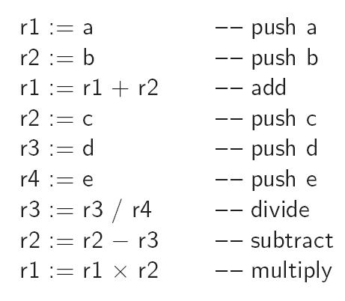
Code Generation
Copyright © 2009 Elsevier

Slide 20
Code Generation
In a particularly complicated fragment of code it is possible to run out of architectural registers.
  In this case we must spill one or more registers to memory
Our naive register allocator pushes a register onto the program’s subroutine call stack
  In effect, architectural registers hold the top k elements of an expression evaluatio stack of effectively unlimited size
It should be emphasized that our register allocation algorithm, makes very poor use of machine resources
If we were generating medium level intermediate code, we would employ virtual registers, rather than architectural ones
  Mapping of virtual registers to architectural registers would occur much later in the compilation process.
Target code for the GCD program appears in Figure 14.7.
Copyright © 2009 Elsevier

Slide 21
Address Space Organization
Assemblers, linkers, and loaders typically operate on a pair of related file formats
  relocatable object code
  executable object code
Relocatable object code is acceptable as input to a linker
  multiple files in this format can be combined to create an executable program
Executable object code is acceptable as input to a loader:
  it can be brought into memory and run
Copyright © 2009 Elsevier

Slide 22
Address Space Organization
A relocatable object file includes the following descriptive information:
  import table: Identifies instructions that refer to named locations whose addresses are unknown, but are presumed to lie in other files yet to be linked to this one
  relocation table: Identifies instructions that refer to locations within the current file, but that must be modified at link time to reflect the offset of the current file within the final, executable program
  export table: Lists the names and addresses of locations in the current file that may be referred to in other files
Imported and exported names are known as external symbols
Copyright © 2009 Elsevier

Slide 23
Address Space Organization
Running program segments
  code
  constants
  initialized data
  uninitialized data: may be allocated at load time or on demand in response to page faults
    Usually zero filled, both to provide repeatable symptoms for programs that erroneously read data they have not yet written
  stack: may be allocated in some fixed amount at load time
    more commonly, is given a small initial size, and then
    extended automatically by the operating system in response to (faulting) accesses beyond the current segment end.
Copyright © 2009 Elsevier

Slide 24
Address Space Organization
Running program segments (2):
  heap: may also be allocated in some fixed amount at load time.
    more commonly, is given a small initial size, and is then
    extended in response to explicit requests from heap-management library routines
  files: In many systems, library routines allow a program to map a file into memory
    The map routine interacts with the operating system to create a new segment for the file, and returns the address of the beginning of the segment
    the contents of the segment are usually fetched from disk on demand, in response to page faults
  dynamic libraries: Modern operating systems typically arrange for most programs to share a single copy of the code for popular libraries
Copyright © 2009 Elsevier

Slide 25
Assembly
Some compilers translate source files directly into object files acceptable to the linker
More commonly, they generate assembly language that must subsequently be processed by an assembler to create an object file
  symbolic (textual) notation for code.
  within a compiler it would still be symbolic, most likely consisting of records and linked lists
To translate this symbolic representation into executable code, we must
  replace opcodes and operands with their machine language encodings
  replace uses of symbolic names with actual addresses
Copyright © 2009 Elsevier

Slide 26
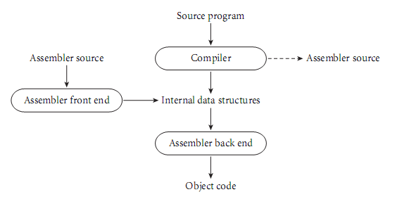
Assembly
When passing assembly language from the compiler to the assembler, it makes sense to use some internal (records and linked lists) representation
At the same time, we must provide a textual front end to accommodate the occasional need for human input:
Copyright © 2009 Elsevier

Slide 27
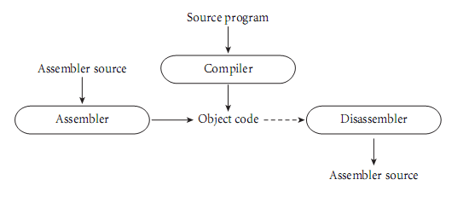
Assembly
An alternative organization has the compiler generate object code directly
  This organization gives the compiler a bit more flexibility: operations normally performed by an assembler (e.g., assignment of addresses to variables) can be performed earlier if desired.
  Because there is no separate assembly pass, the overall translation to object code may be slightly faster
Copyright © 2009 Elsevier

Slide 28
Assembly
Emitting Instructions
  The most basic task of the assembler is to translate symbolic representations of instructions into binary form
  In some assemblers this is easy
    there is a one-one correspondence between mnemonic operations and instruction op-codes
  Many assemblers extend the instruction set in minor ways to make the assembly language easier for human beings to read
  Most MIPS assemblers, for example, provide a large number of pseudo-instructions that translate into different real instructions depending on their arguments, or that correspond to multi-instruction sequences
Copyright © 2009 Elsevier

Slide 29
Assembly
Assemblers respond to a variety of directives (MIPS):
  segment switching
    .text directive indicates that subsequent instructions and data should be placed in the code (text) segment.
    .data directive indicates that subsequent instructions and data should be placed in the initialized data segment.
    .space n directive indicates that n bytes of space should be reserved in the uninitialized data segment
    .byte, .half, .word, .float, and .double directives each take a sequence of arguments
    related .ascii directive takes a single character string as argument, which it places in consecutive bytes
  symbol identification
    .global name directive indicates that name should be entered into the table of exported symbols.
  alignment
    .align n directive causes the subsequent output to be aligned at an address evenly divisible by 2n
Copyright © 2009 Elsevier

Slide 30
Assembly
RISC assemblers implement a virtual machine - instruction set is “nicer” than that of the real hardware
  In addition to pseudo-instructions, the virtual machine may have non-delayed branches
  If desired, the compiler or assembly language programmer can ignore the existence of branch delays
  The assembler will move nearby instructions to fill delay slots if possible, or generate nops if necessary.
  To support systems programmers, the assembler must also make it possible to specify that delay slots have already been filled
Copyright © 2009 Elsevier

Slide 31
Assembly
Assemblers commonly work in several phases
  if the input is textual, an initial phase scans and parses the input, and builds an internal representation
  there are two additional phases.
    first phase identifies all internal and external (imported) symbols, assigning locations to the internal ones
      complicated by the length of some instructions (on a CISC machine)
      or
      complicated by number of real instructions produced by a pseudo-instruction (on a RISC machine)
    final phase produces object code
Copyright © 2009 Elsevier

Slide 32
Assembly
CISC assemblers distinguish between absolute and relocatable words in an object file
Absolute words are known at assembly time; they need not be changed by the linker
  constants and register-register instructions
A relocatable word must be modified by adding to it the address within the final program of the code or data segment of the current object file
  A CISC jump instruction might consist of a one-byte jmp opcode followed by a four-byte target address
  For a local target, the address bytes in the object file would contain the symbol’s offset within the file
  The linker finalizes the address by adding the offset of the file’s code segment within the final program
Copyright © 2009 Elsevier

Slide 33
Linking
Most language implementations - certainly all that are intended for the construction of large programs - support separate compilation
  fragments of the program can be compiled and assembled more-or-less independently
After compilation, these fragments (known as compilation units) are “glued together” by a linker
  programmer explicitly divides the program into modules or files separately compiled
  integrated environments may abandon the notion of a file in favor of a database of subroutines separately compiled
Linker joins together compilation units
Copyright © 2009 Elsevier

Slide 34
Linking
A static linker does its work prior to program execution, producing an executable object file
A dynamic linker does its work after the program has been brought into memory for execution
Each of the compilation units of a program to be linked must be a relocatable object file
  some files will have been produced by compiling fragments of the application being constructed
  others will be general purpose library packages needed by the application
Since most programs make use of libraries, even a “one-file” application typically needs to be linked
Copyright © 2009 Elsevier

Slide 35
Linking
Linking involves two subtasks: relocation and the resolution of external references
Some authors refer to relocation as loading, and call the entire “joining together” process “link-loading.”
In this book we use “loading” to refer to the process of bringing an executable object file into memory for execution
  on very simple machines loading entails relocation
  the operating system uses virtual memory to giving the impression that it starts at some standard address (zero)
  often loading also entails a certain amount of linking
Copyright © 2009 Elsevier

Slide 36
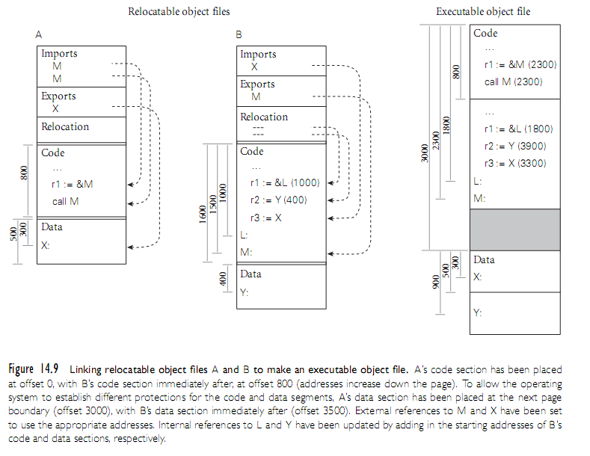
Linking
Copyright © 2009 Elsevier

Slide 37
Dynamic Linking
On a multi-user system, it is common for several instances of a program (an editor or web browser, for example) to be executing simultaneously
  It would be highly wasteful to allocate space in memory for a separate, identical copy of the code of such a program for every running instance
Many operating systems therefore keep track of the programs that are running, and set up memory mapping tables so that all instances of the same program share the same read-only copy of the program’s code segment
  Each instance receives its own writable copy of the data segment
  Code segment sharing can save enormous amounts of space
  It does not work, however, for instances of programs that
  are similar but not identical
Copyright © 2009 Elsevier

